Slide 1
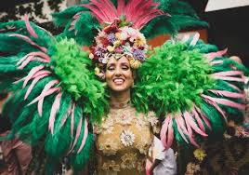
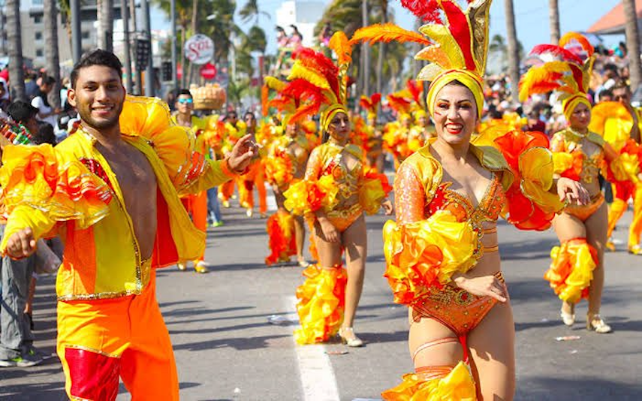
Introduction
Hoilday: Carnaval de Veracruz
By Tom And Robin

Slide 2
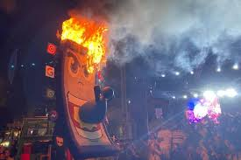
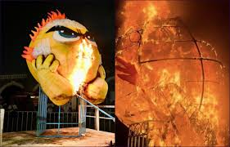
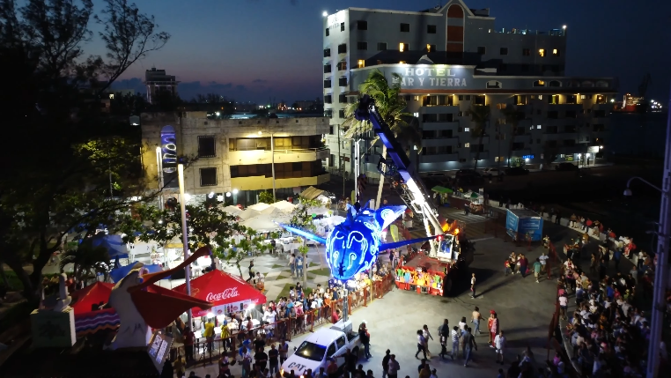
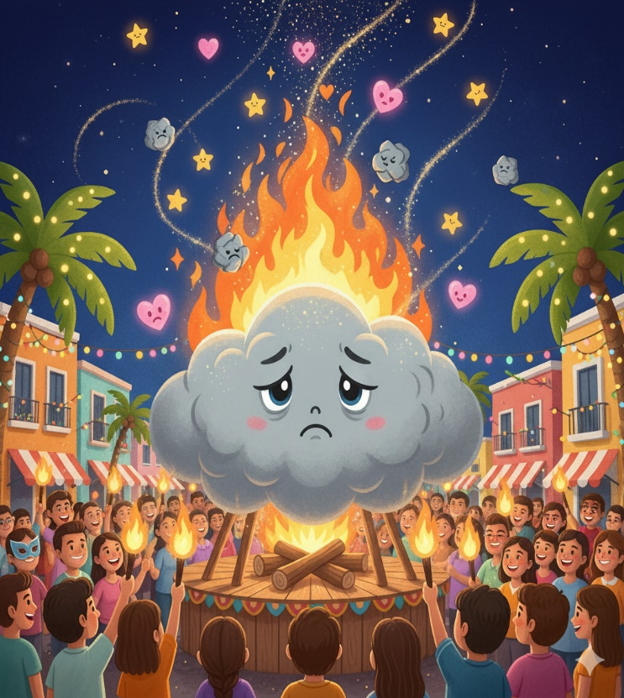
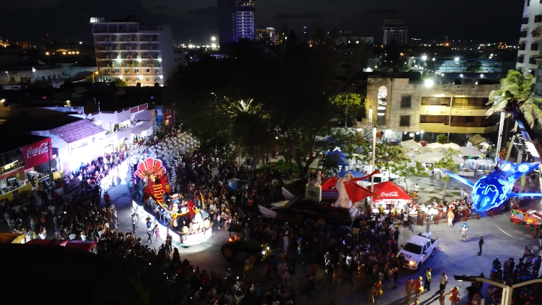
Burning of Bad Mood

Slide 3
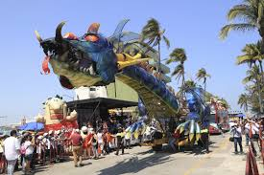
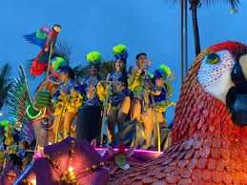
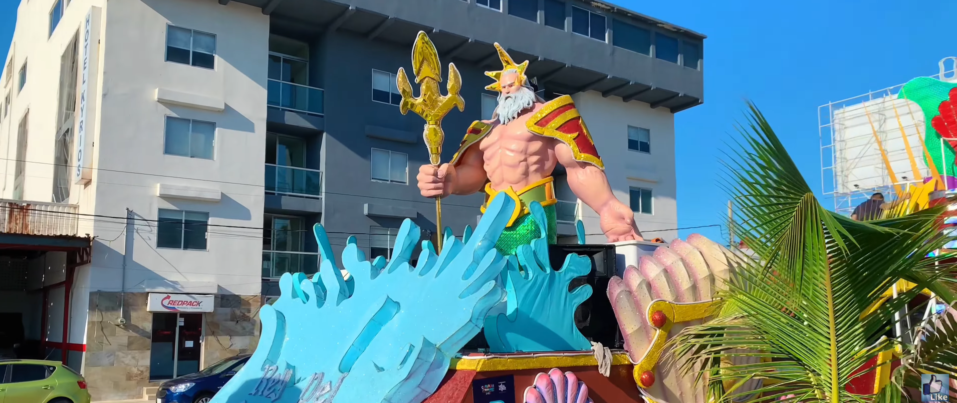
Parades and Dances

Slide 4
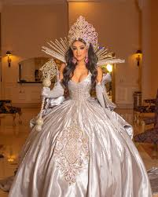
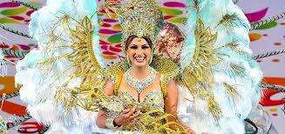
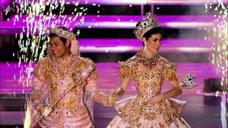
Carnival queen and king

Slide 5
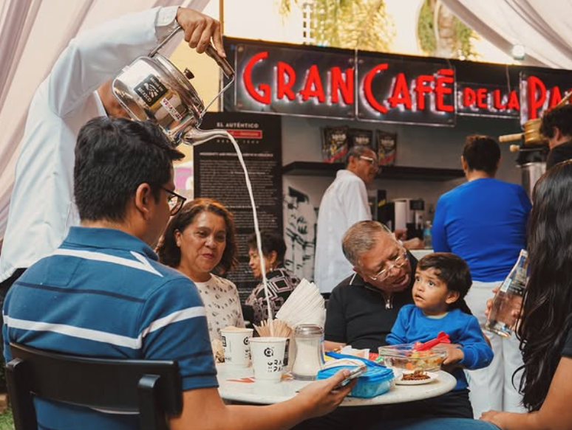
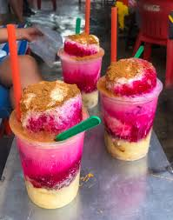
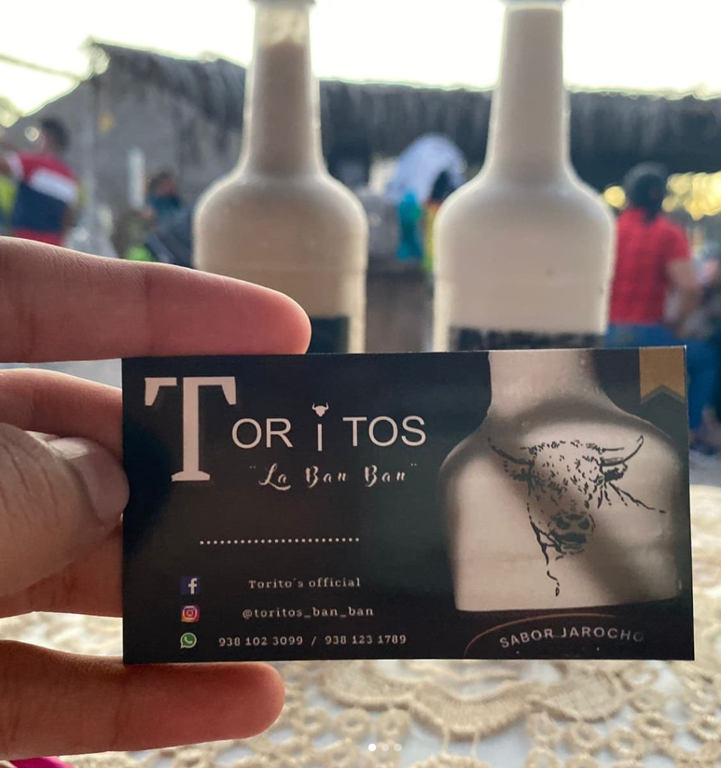

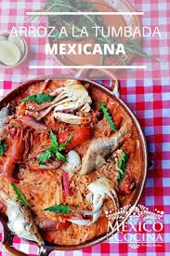
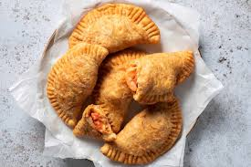
Food:EatEatEatEatEatEatEatEatEatEatEatEatEatEatEatEatEatEatEatEatEatEatEatEatEatEatEatEatEatEatEatEat
EatEatEatEatEatEatEatEatEatEatEatEatEatEatEatEatEatEatEatEatEatEatEatEatEatEat
Eat
Eat
Eat
Eat
Eat
Eat
Eat
Eat
Eat
Eat
Eat
Eat
Eat
Eat
Eat
Eat
Eat
Eat
Eat
Eat
Eat
Eat
Eat
Eat
Eat
Eat
Eat
Eat
Eat
Eat
Eat
Eat
Eat
Eat
Eat
Eat
Eat
Eat
Eat
Eat
Eat
Eat
Eat
Eat
Eat
Eat
Eat
Eat

Slide 6


Summary

Slide 7

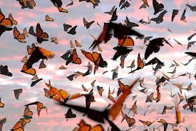
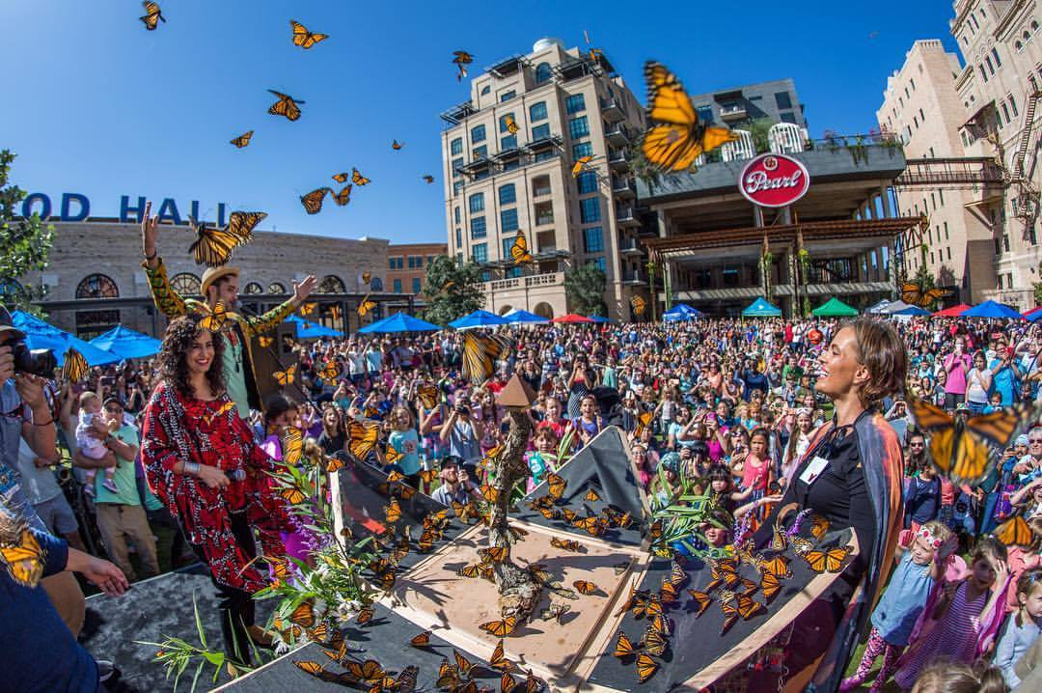
Butterfly Migration Festival

Slide 8
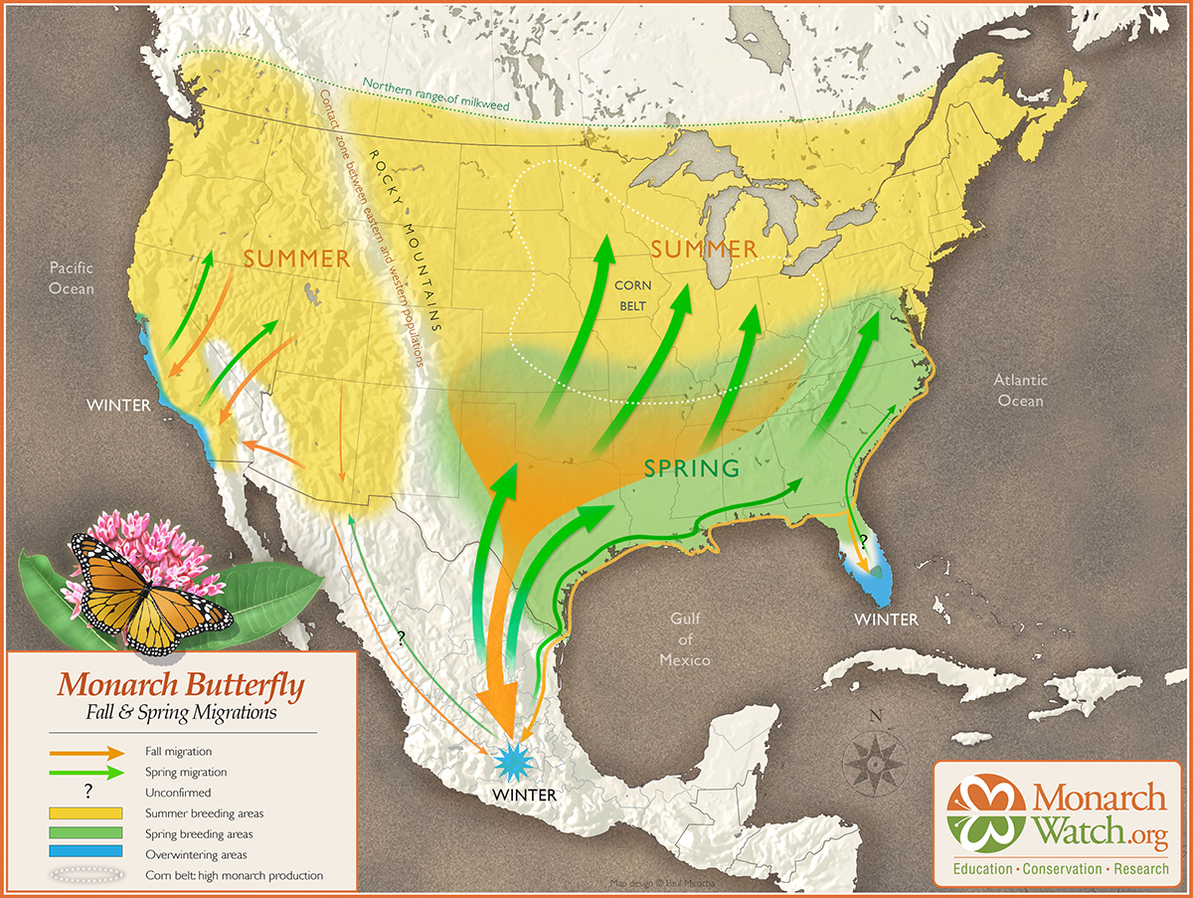
Butterfly Migration Festival

Slide 9
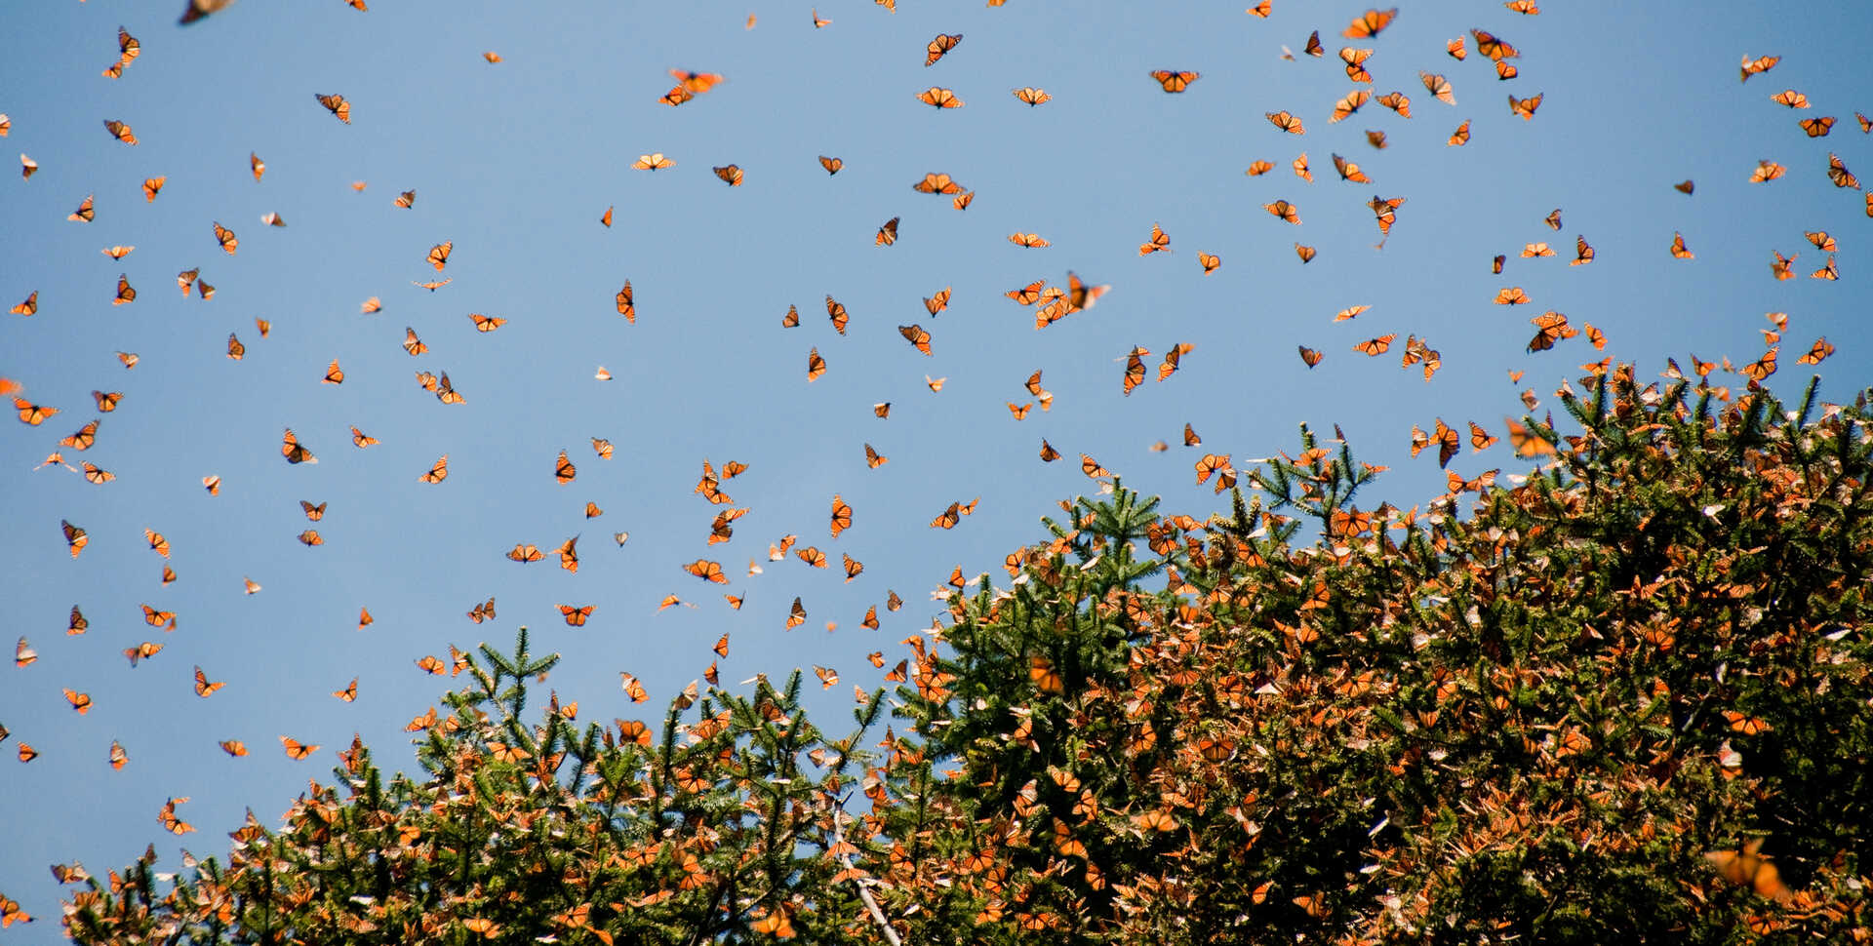
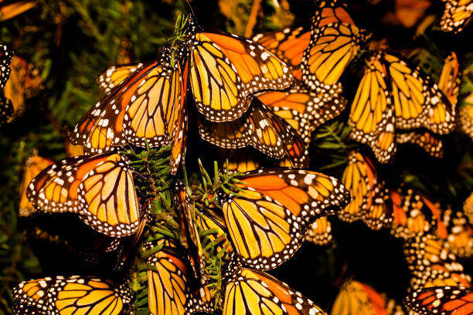
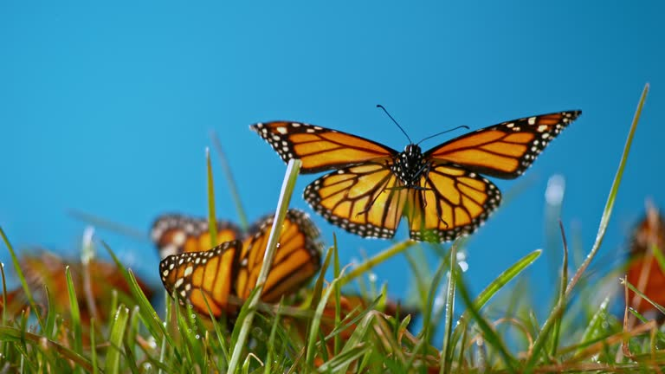
Butterfly Migration Festival

Slide 10
Thank you for you listening！
Tom And Robin

